Slide 1
Lab 3
ONOS Application Development:
SDN-enabled Learning Bridge and Proxy ARP
助教: 惠品嘉 黃琮閔
sdnta@win.cs.nycu.edu.tw
Deadline: 2024/10/16 23:59

Slide 2
Outline
Build ONOS Application Project
Environment Setup
Create an ONOS Application
Build, Install, Activate, and Reinstall ONOS Application
ARP
Introduction
ARP Request/Reply Format
Learning Bridge Function
Introduction
Workflow
Proxy APR
Introduction
Workflow
Lab 3 Requirements

Slide 3
Outline
Build ONOS Application Project
Environment Setup
Create an ONOS Application
Build, Install, Activate, and Reinstall ONOS Application
ARP
Introduction
ARP Request/Reply Format
Learning Bridge Function
Introduction
Workflow
Proxy APR
Introduction
Workflow
Lab 3 Requirements

Slide 4
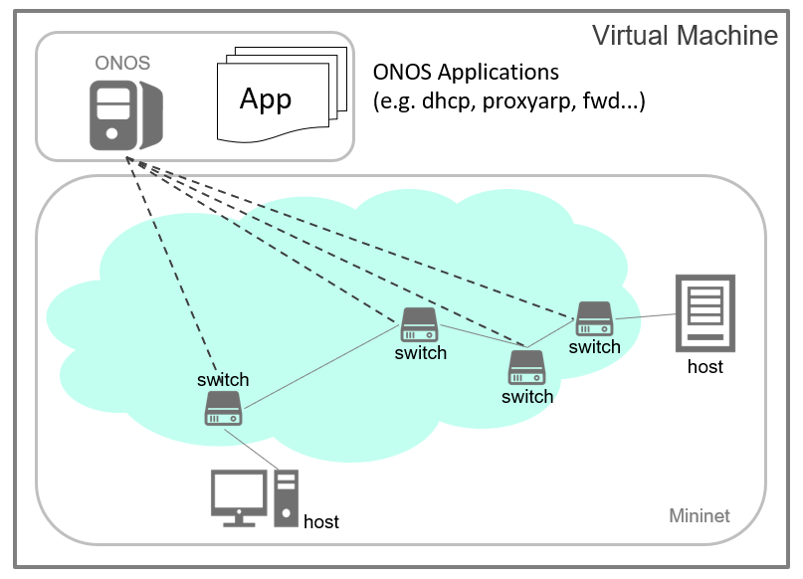
Overview

Slide 5
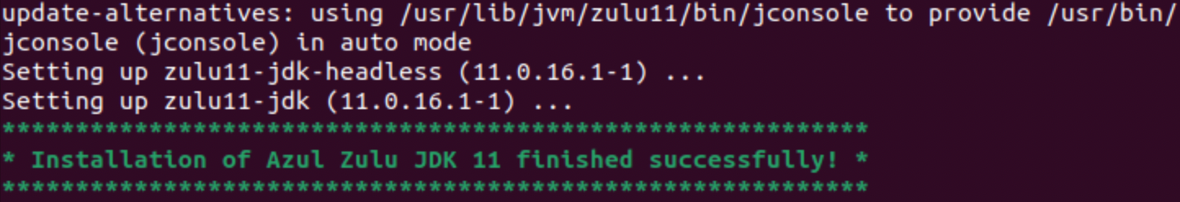
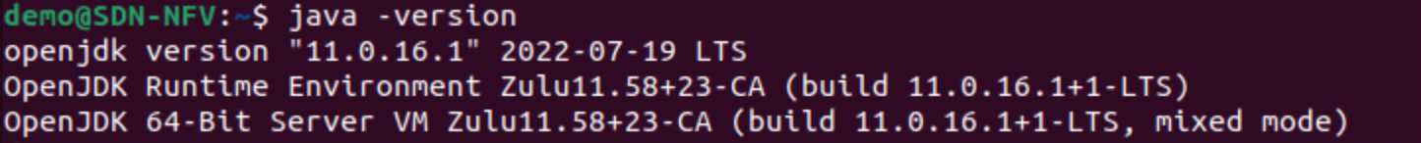
JDK Installation
Download the “install_jdk” script from E3.
Add execution permission to the script:
Execute the script:
Once the installation finishes, you will see a success message:
Check the installed JDK version:
$ chmod +x install_jdk
$ ./install_jdk
$ java -version

Slide 6
Apache Maven
A software project management and comprehension tool.
Based on the concept of a Project Object Model (POM).
Manage a project's build, reporting and documentation from a central piece of information.
It has been intalled in your VM by the “env_setup” script in Lab 1.
Official website: https://maven.apache.org/

Slide 7
Build ONOS Application Archetypes
We will use onos-create-app command to generate an ONOS application template.
onos-create-app command relies on the ONOS archetypes.
We need to build ONOS archetypes first.
Steps:
Specify ONOS version:
Build archetypes:
-DskipTests: Skip running tests of the project.
$ export ONOS_POM_VERSION=2.7.0
$ cd $ONOS_ROOT/tools/package/archetypes
$ mvn clean install -DskipTests

Slide 8
Build ONOS Application Template
Run onos-create-app.
$ onos-create-app
...
[INFO] ...
Define value for property 'groupId': nycu.winlab
Define value for property 'artifactId': bridge-app
Define value for property 'version' 1.0-SNAPSHOT: : <enter>
Define value for property 'package' nycu.winlab: : nycu.winlab.bridge
Confirm properties configuration:
onosVersion: 2.7.0
groupId: nycu.winlab
artifactId: bridge-app
version: 1.0-SNAPSHOT
package: nycu.winlab.bridge
Y: : <enter>
[INFO] ...
...
[INFO] BUILD SUCCESS
Archive ID for the created ONOS application.

Slide 9
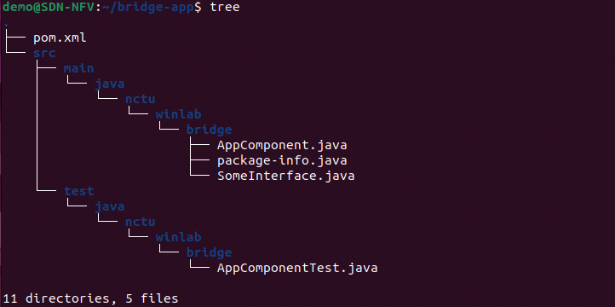
Folder Structure of Created ONOS Application
onos-create-app command creates a folder named bridge-app (artifactId).
Structure of bridge-app folder:
bridge-app

Slide 10
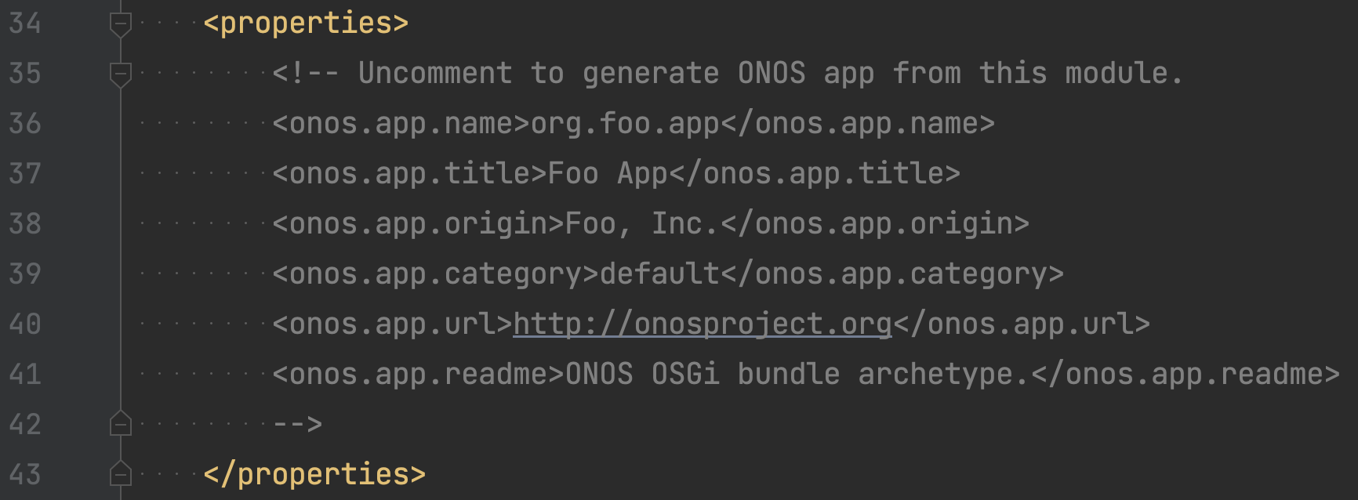
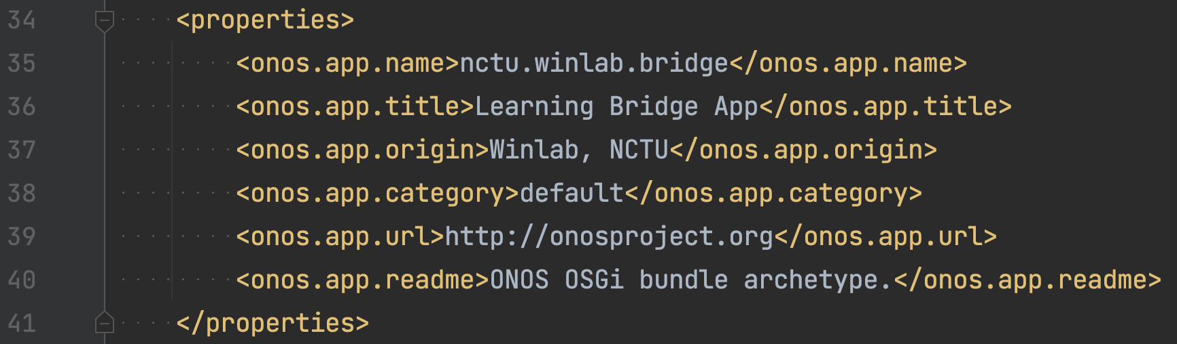
Modify ONOS Application Properties
Modify Project Object Model file pom.xml to describe your project.
pom.xml Before
pom.xml After

Slide 11
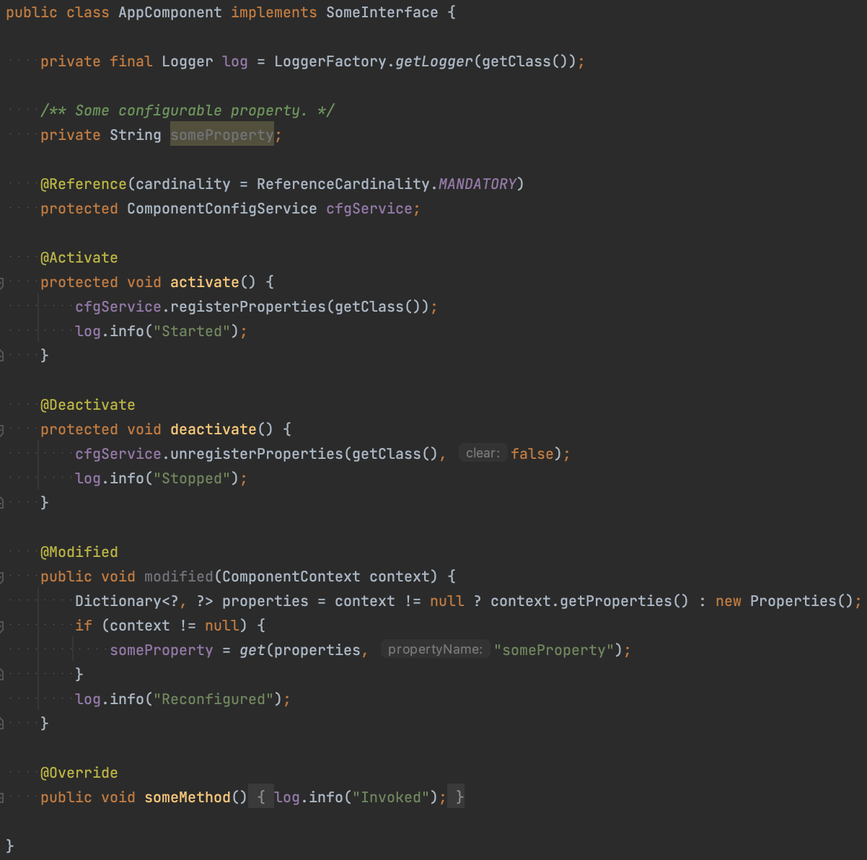

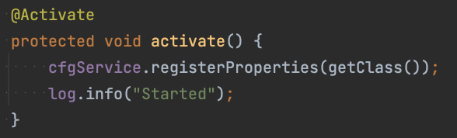
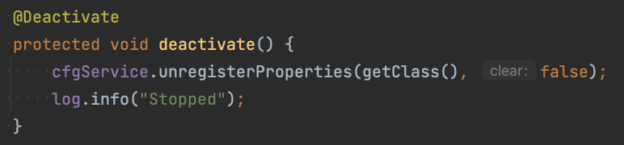
Overview of AppComponent.java
AppComponent.java code template.
Inject a dependent service in ONOS Core.
Executed when app activated.
Executed when app deactivated.
Notes:
* 稍微講解一下 component config service 幹嘛的，下個 lab 會用到
* 定義 processor 可以寫成 inner class 也可以寫成 outter class

Slide 12
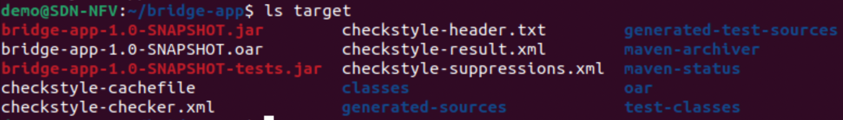
Build, Install and Activate ONOS Application
Build ONOS application:
Run ONOS:
Install and activate ONOS application:
install!: Install and activate application immediately.
# In the root of your application folder.
$ ﻿mvn clean install -DskipTests
built results
$ cd $ONOS_ROOT
$ bazel run onos-local -- clean debug
# In the root of your application folder.
$ onos-app localhost install! target/<artifactId>-<version>.oar
(bridge-app-1.0-SNAPSHOT.oar)
Notes:
* onos-local 為一個 bazel target (key)，存於 “BUILD” file

Slide 13
Reinstall ONOS Application
If you modify your application, you need to rebuild and reinstall it on ONOS.
Rebuild application of new version:
Deactivate application of old version on ONOS:
<onos.app.name> is set in your pom.xml. e.g. nycu.winlab.bridge
Uninstall application of old version:
Install and activate application of new version:
# In the root of your application folder.
$ ﻿mvn clean install -DskipTests
$ onos-app localhost deactivate <onos.app.name>
$ onos-app localhost uninstall <onos.app.name>
# In the root of your application folder.
$ onos-app localhost install! target/<artifactId>-<version>.oar

Slide 14
References
Install Azul Zulu on Debian-based Linux
ONOS Wiki – Template Application Tutorial
ONOS Application Subsystem
ONOS Java API (2.7.0)

Slide 15
Outline
Build ONOS Application Project
Environment Setup
Create an ONOS Application
Build, Install, Activate, and Reinstall ONOS Application
ARP
Introduction
ARP Request/Reply Format
Learning Bridge Function
Introduction
Workflow
Proxy APR
Introduction
Workflow
Lab 3 Requirements

Slide 16
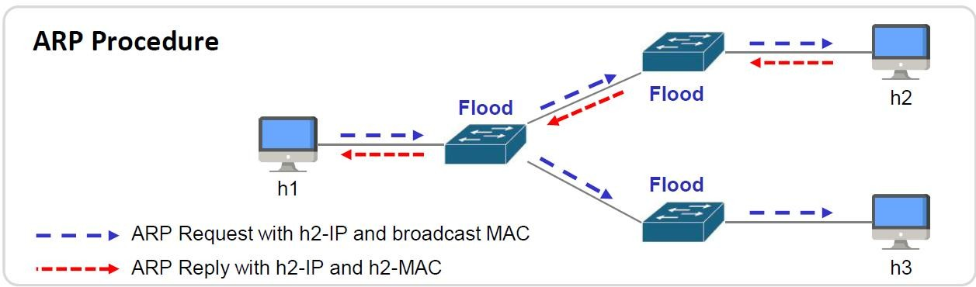
What is Address Resolution Protocol (ARP)
Used to discover Link Layer address (e.g. MAC) with the given Network Layer address (e.g. IPv4)
Use flooding to discover devices
‒ Destination Ethernet address of ARP Request is broadcast address
Hosts maintain an ARP table for mapping IP address to MAC

Slide 17
ARP Request Packet Format
e.g. h1 sends ARP request to h2
Hardware Type (Ethernet = 1) |  | Protocol Type (IPv4 = 0x0800)
Hardware Length (Ethernet = 6) | Protocol Length (IPv4 = 4) | Operation Code (Request = 0x1)
Sender Hardware Address (h1-MAC)
Sender Protocol Address (h1-IP)
Target Hardware Address (00:00:00:00:00:00)
Target Protocol Address (h2-IP)

Slide 18
ARP Reply Packet Format
e.g. h2 sends ARP reply to h1
Hardware Type (Ethernet = 1) |  | Protocol Type (IPv4 = 0x0800)
Hardware Length (Ethernet = 6) | Protocol Length (IPv4 = 4) | Operation Code (Reply = 0x2)
Sender Hardware Address (h2-MAC)
Sender Protocol Address (h2-IP)
Target Hardware Address (h1-MAC)
Target Protocol Address (h1-IP)

Slide 19
Outline
Build ONOS Application Project
Environment Setup
Create an ONOS Application
Build, Install, Activate, and Reinstall ONOS Application
ARP
Introduction
ARP Request/Reply Format
Learning Bridge Function
Introduction
Workflow
Proxy APR
Introduction
Workflow
Lab 3 Requirements

Slide 20
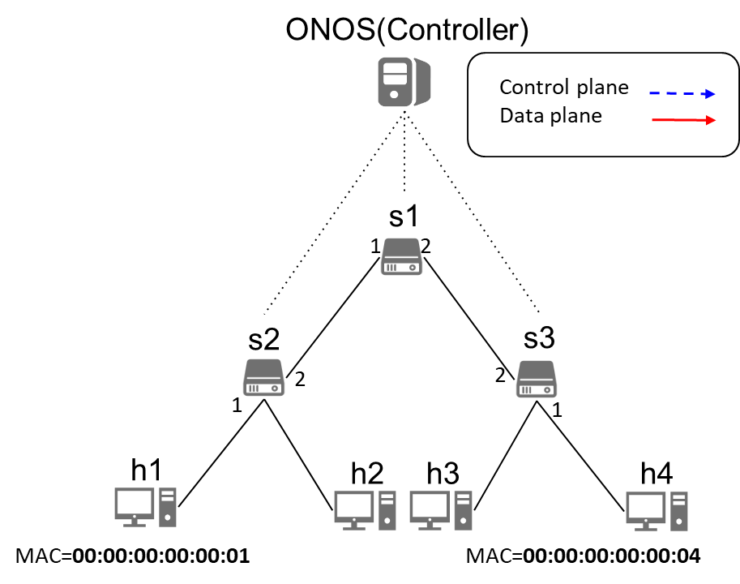
Learning Bridge Functionality
s1 |  | s2 |  | s3
MAC | Port | MAC | Port | MAC | Port
Switch functionality:
When receives a packet, matches Destination MAC
Matched: Forwards packet via specified port
Not matched: Packet-in
ONOS App functionality:
When receives a Packet-in
Records Source MAC and incoming port (in forwarding table)
Looks up Destination MAC (in forwarding table)
Not found:
Floods Packet-out.
Found:
Sends Packet-out via designated port.
Installs flow rule on switch.

Slide 21
Request for Packet-in
When App is activated, it installs a rule on each switch.
To request Packet-in for IPv4 packets.
With very low priority.
Don’t forget to cancel the request for Packet-in when your App is deactivated.

Slide 22
Workflow (h1 -> h4)
h1 pings h4.
Switch sends Packet-in to Controller.
Controller updates MAC address table with source MAC and incoming port.
Controller looks up MAC address table for destination MAC:
Destination MAC not found:
Floods Packet-out.
Destination MAC found:
Sends Packet-out via designated port.
Installs flow rule on switch.
h4 receives packet from h1.
s1 |  | s2 |  | s3
MAC | Port | MAC | Port | MAC | Port
(1)
Notes:
P4 怎麼實作 packet out 的 Flooding?

Slide 23
Workflow (h1 -> h4)
h1 pings h4.
Switch (s2) sends Packet-in to Controller.
Controller updates MAC address table with source MAC and incoming port.
Controller looks up MAC address table for destination MAC:
Destination MAC not found:
Floods Packet-out.
Destination MAC found:
Sends Packet-out via designated port.
Installs flow rule on switch.
h4 receives packet from h1.
s1 |  | s2 |  | s3
MAC | Port | MAC | Port | MAC | Port
(2)
(1)

Slide 24
Workflow (h1 -> h4)
h1 pings h4.
Switch sends Packet-in to Controller.
Controller updates MAC address table with source MAC and incoming port.
Controller looks up MAC address table for destination MAC:
Destination MAC not found:
Floods Packet-out.
Destination MAC found:
Sends Packet-out via designated port.
Installs flow rule on switch.
h4 receives packet from h1.
s1 |  | s2 |  | s3
MAC | Port | MAC | Port | MAC | Port
 |  | 00:.....:01 | 1
(3)
(2)
(1)
Notes:
不 preinstall backforward path 的 rules 是因為要讓 h4 回應的 packet 可以 packet-in，這樣 controller 才有機會學到去程的 forwarding table

Slide 25
Workflow (h1 -> h4)
h1 pings h4.
Switch sends Packet-in to Controller.
Controller updates MAC address table with source MAC and incoming port.
Controller looks up MAC address table for destination MAC:
Destination MAC not found:
Floods Packet-out.
Destination MAC found:
Sends Packet-out via designated port.
Installs flow rule on switch.
h4 receives packet from h1.
s1 |  | s2 |  | s3
MAC | Port | MAC | Port | MAC | Port
 |  | 00:.....:01 | 1
(3)
(4)
(2)
(1)

Slide 26
Workflow (h1 -> h4)
h1 pings h4.
Switch sends Packet-in to Controller.
Controller updates MAC address table with source MAC and incoming port.
Controller looks up MAC address table for destination MAC:
Destination MAC not found:
Floods Packet-out.
Destination MAC found:
Sends Packet-out via designated port.
Installs flow rule on switch.
h4 receives packet from h1.
s1 |  | s2 |  | s3
MAC | Port | MAC | Port | MAC | Port
 |  | 00:.....:01 | 1
(3)
(4)
(2)
(a)
(1)

Slide 27
Workflow (h1 -> h4)
h1 pings h4.
Switch sends Packet-in to Controller.
Controller updates MAC address table with source MAC and incoming port.
Controller looks up MAC address table for destination MAC:
Destination MAC not found:
Floods Packet-out.
Destination MAC found:
Sends Packet-out via designated port.
Installs flow rule on switch.
h4 receives packet from h1.
s1 |  | s2 |  | s3
MAC | Port | MAC | Port | MAC | Port
 |  | 00:.....:01 | 1
(3)
(4)
(2)
(a)
(a)
(1)
(a)

Slide 28
Workflow (h1 -> h4)
h1 pings h4.
Switch (s1) sends Packet-in to Controller.
Controller updates MAC address table with source MAC and incoming port.
Controller looks up MAC address table for destination MAC:
Destination MAC not found:
Floods Packet-out.
Destination MAC found:
Sends Packet-out via designated port.
Installs flow rule on switch.
h4 receives packet from h1.
s1 |  | s2 |  | s3
MAC | Port | MAC | Port | MAC | Port
 |  | 00:.....:01 | 1
(3)
(4)
(2)
(a)
(a)
(1)
(a)

Slide 29
Workflow (h1 -> h4)
h1 pings h4.
Switch sends Packet-in to Controller.
Controller updates MAC address table with source MAC and incoming port.
Controller looks up MAC address table for destination MAC:
Destination MAC not found:
Floods Packet-out.
Destination MAC found:
Sends Packet-out via designated port.
Installs flow rule on switch.
h4 receives packet from h1.
s1 |  | s2 |  | s3
MAC | Port | MAC | Port | MAC | Port
 |  | 00:.....:01 | 1
(3)
(4)
(2)
(a)
Skip repeated steps...
(a)
(1)
(a)

Slide 30
Workflow (h1 -> h4)
h1 pings h4.
Switch sends Packet-in to Controller.
Controller updates MAC address table with source MAC and incoming port.
Controller looks up MAC address table for destination MAC:
Destination MAC not found:
Floods Packet-out.
Destination MAC found:
Sends Packet-out via designated port.
Installs flow rule on switch.
h4 receives packet from h1.
s1 |  | s2 |  | s3
MAC | Port | MAC | Port | MAC | Port
00:.....:01 | 1 | 00:.....:01 | 1 | 00:.....:01 | 2
(3)
(4)
(2)
(a)
(a)
(1)
(a)
(5)

Slide 31
Workflow (h4 -> h1)
h4 replies to h1.
Switch sends Packet-in to Controller.
Controller updates MAC address table with source MAC and incoming port.
Controller looks up MAC address table for destination MAC:
Destination MAC not found:
Floods Packet-out.
Destination MAC found:
Sends Packet-out via designated port.
Installs flow rule on switch.
h1 receives packet from h4.
s1 |  | s2 |  | s3
MAC | Port | MAC | Port | MAC | Port
00:.....:01 | 1 | 00:.....:01 | 1 | 00:.....:01 | 2
(1)

Slide 32
Workflow (h4 -> h1)
h4 replies to h1.
Switch (s3) sends Packet-in to Controller.
Controller updates MAC address table with source MAC and incoming port.
Controller looks up MAC address table for destination MAC:
Destination MAC not found:
Floods Packet-out.
Destination MAC found:
Sends Packet-out via designated port.
Installs flow rule on switch.
h1 receives packet from h4.
s1 |  | s2 |  | s3
MAC | Port | MAC | Port | MAC | Port
00:.....:01 | 1 | 00:.....:01 | 1 | 00:.....:01 | 2
(2)
(1)

Slide 33
Workflow (h4 -> h1)
h4 replies to h1.
Switch sends Packet-in to Controller.
Controller updates MAC address table with source MAC and incoming port.
Controller looks up MAC address table for destination MAC:
Destination MAC not found:
Floods Packet-out.
Destination MAC found:
Sends Packet-out via designated port.
Installs flow rule on switch.
h1 receives packet from h4.
s1 |  | s2 |  | s3
MAC | Port | MAC | Port | MAC | Port
00:.....:01 | 1 | 00:.....:01 | 1 | 00:.....:01 | 2
 |  |  |  | 00:.....:04 | 1
(3)
(2)
(1)

Slide 34
Workflow (h4 -> h1)
h4 replies to h1.
Switch sends Packet-in to Controller.
Controller updates MAC address table with source MAC and incoming port.
Controller looks up MAC address table for destination MAC:
Destination MAC not found:
Floods Packet-out.
Destination MAC found:
Sends Packet-out via designated port.
Installs flow rule on switch.
h1 receives packet from h4.
s1 |  | s2 |  | s3
MAC | Port | MAC | Port | MAC | Port
00:.....:01 | 1 | 00:.....:01 | 1 | 00:.....:01 | 2
 |  |  |  | 00:.....:04 | 1
(3)
(4)
(2)
(1)

Slide 35

Workflow (h4 -> h1)
h4 replies to h1.
Switch sends Packet-in to Controller.
Controller updates MAC address table with source MAC and incoming port.
Controller looks up MAC address table for destination MAC:
Destination MAC not found:
Floods Packet-out.
Destination MAC found:
Sends Packet-out via designated port.
Installs flow rule on switch.
h1 receives packet from h4.
s1 |  | s2 |  | s3
MAC | Port | MAC | Port | MAC | Port
00:.....:01 | 1 | 00:.....:01 | 1 | 00:.....:01 | 2
 |  |  |  | 00:.....:04 | 1
(3)
(4)
(2)
(b)
(1)

Slide 36
Workflow (h4 -> h1)
h4 replies to h1.
Switch sends Packet-in to Controller.
Controller updates MAC address table with source MAC and incoming port.
Controller looks up MAC address table for destination MAC:
Destination MAC not found:
Floods Packet-out.
Destination MAC found:
Sends Packet-out via designated port.
Installs flow rule on switch.
h1 receives packet from h4.
s1 |  | s2 |  | s3
MAC | Port | MAC | Port | MAC | Port
00:.....:01 | 1 | 00:.....:01 | 1 | 00:.....:01 | 2
 |  |  |  | 00:.....:04 | 1
(3)
(4)
(2)
(b)
(b)
(1)

Slide 37
Workflow (h4 -> h1)
h4 replies to h1.
Switch (s1) sends Packet-in to Controller.
Controller updates MAC address table with source MAC and incoming port.
Controller looks up MAC address table for destination MAC:
Destination MAC not found:
Floods Packet-out.
Destination MAC found:
Sends Packet-out via designated port.
Installs flow rule on switch.
h1 receives packet from h4.
s1 |  | s2 |  | s3
MAC | Port | MAC | Port | MAC | Port
00:.....:01 | 1 | 00:.....:01 | 1 | 00:.....:01 | 2
 |  |  |  | 00:.....:04 | 1
(3)
(4)
(2)
(b)
(b)
(1)

Slide 38
Workflow (h4 -> h1)
h4 replies to h1.
Switch sends Packet-in to Controller.
Controller updates MAC address table with source MAC and incoming port.
Controller looks up MAC address table for destination MAC:
Destination MAC not found:
Floods Packet-out.
Destination MAC found:
Sends Packet-out via designated port.
Installs flow rule on switch.
h1 receives packet from h4.
s1 |  | s2 |  | s3
MAC | Port | MAC | Port | MAC | Port
00:.....:01 | 1 | 00:.....:01 | 1 | 00:.....:01 | 2
 |  |  |  | 00:.....:04 | 1
(3)
(4)
(2)
(b)
Skip repeated steps...
(b)
(1)

Slide 39
Workflow (h4 -> h1)
h4 replies to h1.
Switch sends Packet-in to Controller.
Controller updates MAC address table with source MAC and incoming port.
Controller looks up MAC address table for destination MAC:
Destination MAC not found:
Floods Packet-out.
Destination MAC found:
Sends Packet-out via designated port.
Installs flow rule on switch.
h1 receives packet from h4.
s1 |  | s2 |  | s3
MAC | Port | MAC | Port | MAC | Port
00:.....:01 | 1 | 00:.....:01 | 1 | 00:.....:01 | 2
00:.....:04 | 2 | 00:.....:04 | 2 | 00:.....:04 | 1
(3)
(4)
(2)
(b)
(b)
(5)
(1)

Slide 40
Outline
Build ONOS Application Project
Environment Setup
Create an ONOS Application
Build, Install, Activate, and Reinstall ONOS Application
ARP
Introduction
ARP Request/Reply Format
Learning Bridge Function
Introduction
Workflow
Proxy APR
Introduction
Workflow
Lab 3 Requirements

Slide 41
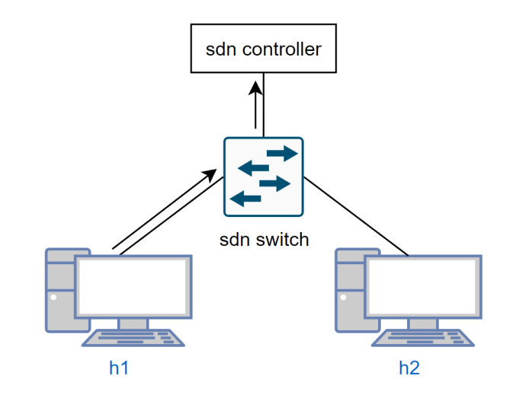
What is Proxy ARP
A Proxy device answers ARP Requests for IP address on behalf of other devices
‒ The Proxy device could be router, firewall, etc.
‒ The replied MAC belongs to the Proxy device
In SDNs, controller can serve as Proxy device
‒ However, the replied MAC belongs to the target host
‒ Benefits:
Decreases workload of network devices
Prevent issues like broadcast storm
h1 send ARP Request

Slide 42
NYCU CS
Workflow of Proxy ARP in SDN
Sender sends ARP Request
Edge switch Packet-Ins the Request to controller
Proxy ARP learns IP-MAC mappings of the sender
Proxy ARP looks up ARP table (For target IP-MAC mapping)
If mapping exist:
Fetch target MAC
5a. Packet-Outs ARP Reply (with target MAC) to the sender
Else (mapping not exist):
5b. Floods ARP Request to edge ports except the port receiving ARP Request
6. When h2 receives ARP Request, h2 will Reply ARP packet.
7. Edge switch Packet-Ins the Reply to controller
8. Proxy ARP learns IP-MAC mapping from h2

Slide 43


NYCU CS
First ARP Request
1. h1 sends ARP Request
2. Edge switch Packet-Ins the Request to controller
ARP Table
ProxyARP
Controller
Packet-In
h2
ARP Request
switches
ARP Request
ARP Reply
h1
s1
s2
h3
s3
43

Slide 44
NYCU CS
Proxy ARP learns IP-MAC
3. Controller learns mapping of IP to MAC of h1
4. Proxy ARP looks up ARP table (For target IP-MAC mapping)
ARP Table
h1 IP | h1 MAC
ProxyARP
Controller
Packet-In
h2
ARP Request
switches
ARP Request
ARP Reply
h1
s1
s2
h3
s3
44

Slide 45
NYCU CS
If mapping exist
Fetch target MAC
5a. Proxy ARP simply generates and Packet-Outs ARP Reply (with target MAC) to the sender
ARP Table
h1 IP | h1 MAC
h2 IP | h2 MAC
ProxyARP
Controller
Packet-In
Packet-Out
h2
ARP Request
switches
ARP Request
ARP Reply
ARP Reply
h1
s1
s2
h3
s3
45

Slide 46


NYCU CS
If mapping not exist
5b. Floods ARP Request to edge ports except the port receiving ARP Request via Packet-Outs ARP Request
ARP Table
h1 IP | h1 MAC
ProxyARP
Controller
Packet-Out
h2
ARP Request
Packet-Out
switches
ARP Request
ARP Reply
h1
s1
s2
h3
s3
46

Slide 47

NYCU CS
Reply ARP packet
6. When h2 receives ARP Request, h2 will Reply ARP packet.
7. Edge switch Packet-Ins the Reply to controller
ARP Table
h1 IP | h1 MAC
ProxyARP
Controller
Packet-In
ARP Reply
h2
switches
ARP Request
ARP Reply
h1
s1
s2
h3
s3
47

Slide 48
NYCU CS
Proxy ARP learns IP-MAC
8. Proxy ARP learns IP-MAC from h2
ARP Table
h1 IP | h1 MAC
h2 IP | h2 MAC
ProxyARP
Controller
h2
switches
ARP Request
ARP Reply
h1
s1
s2
h3
s3
48

Slide 49
Outline
Build ONOS Application Project
Environment Setup
Create an ONOS Application
Build, Install, Activate, and Reinstall ONOS Application
ARP
Introduction
ARP Request/Reply Format
Learning Bridge Function
Introduction
Workflow
Proxy APR
Introduction
Workflow
Lab 3 Requirements

Slide 50
Lab 3 Descriptions
Complete the given code for learning bridge function (40%)
Correct naming convention in pom (5%)
Learning bridge function is available (20%)
Logs are in the correct format (10%)
Flow rules in hosts are comply with the regulations (5%)
Create an ONOS application for Proxy ARP (60%)
Correct naming convention in pom (10%)
Proxy ARP is available (40%)
Logs are in the correct format (10%)
The two apps will be tested separately
If there's a difference between the image and the text, just go with the text.
We'll be providing a template for the learning bridge app at E3

Slide 51
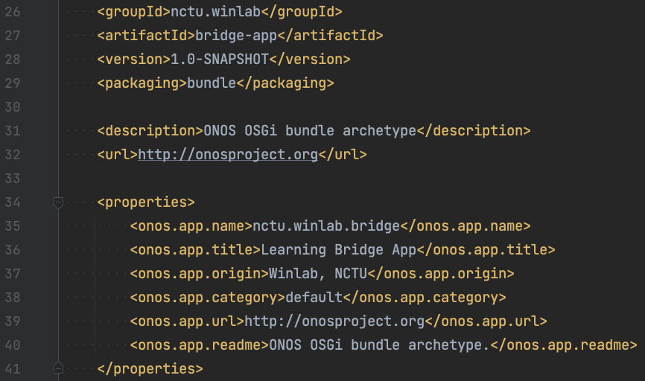
Learning Bridge Function
You must set values in the pom.xml file as the following: (5%)
<groupId>: nycu.winlab
<artifactId>: bridge-app
<version>: (default)
<onos.app.name>: nycu.winlab.bridge
You earn credits only if all settings are correct.
Notes:
artifactId 的部分要改 marking 的 code

Slide 52
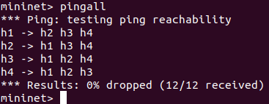
Learning Bridge Function
Ping should work for all host pairs.
Learning Bridge Function with tree (depth=2) topology. (10%)
Learning Bridge Function with tree (depth=3~5) topology. (10%)
You earn credits only if your application works for all depths.
mininet> pingall
$ sudo mn --controller=remote,127.0.0.1:6653 \
--topo=tree,depth=2 \
--switch=ovs,protocols=OpenFlow14
52

Slide 53
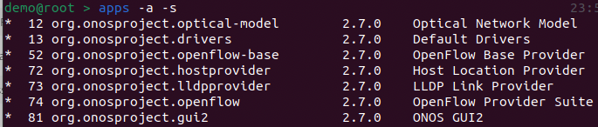
Learning Bridge Function
We will test your application with only the following applications activated:
You must only use classes under org.onosproject.net.flowobjective or org.onosproject.net.flow package to install flow rules on network devices.
If you don't follow this, you won't get any points.
Everyone should really understand how to use both packages to install flow rules.

Slide 54
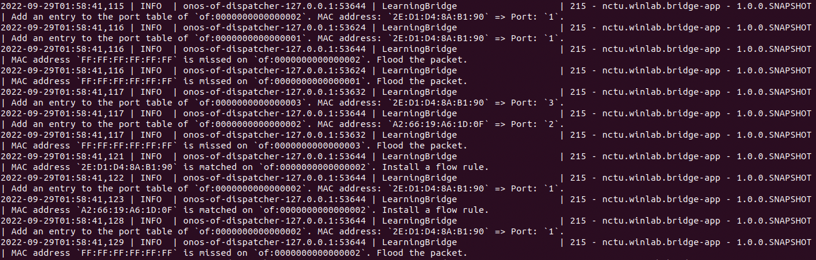
Learning Bridge Function
Use log.info() to record actions done by your application. (10%)
New entry is added into the forwarding table.
Destination MAC address is missed. Flood the packet.
Destination MAC address is matched. Install a flow rule.
You earn credits only if each log pattern is exactly the same as the given one.
1.
2.
3.

Slide 55
Learning Bridge Function
New entry is added into the MAC address table.
Pattern: “Add an entry to the port table of `{device ID}`. MAC address: `{MAC}` => Port: `{port}`.”
Example: “Add an entry to the port table of `of:0000000000000002`. MAC address: `2E:D1:D4:8A:B1:90` => Port: `1`.”
Destination MAC address is missed. Flood the packet.
Pattern: ”MAC address `{MAC}` is missed on `{device ID}`. Flood the packet.”
Example: “MAC address `FF:FF:FF:FF:FF:FF` is missed on `of:0000000000000002`. Flood the packet.”
Destination MAC address is matched. Install a flow rule.
Pattern: ”MAC address `{MAC}` is matched on `{device ID}`. Install a flow rule.”
Example: “MAC address `2E:D1:D4:8A:B1:90` is matched on `of:0000000000000002`. Install a flow rule.”

Slide 56
Learning Bridge Function
Here are examples of how to use log.info() to print log information.

Slide 57
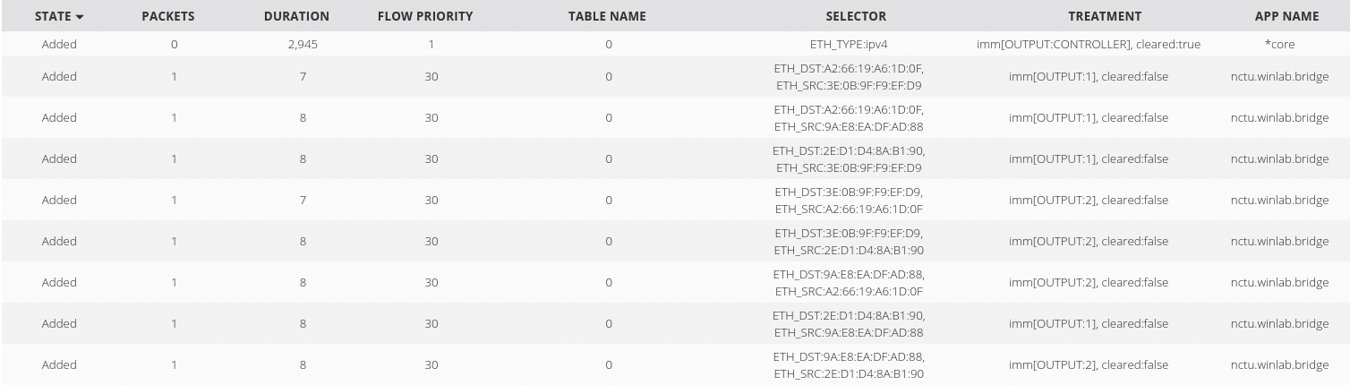
Learning Bridge Function
Rule requirements: (5%)
Match field (selector): ETH_SRC, ETH_DST
Action field (treatment): OUTPUT
Flow priority: 30
Flow timeout: 30
You earn credits only if all flow rules are correct.

Slide 58
Learning Bridge Function
You can trace ReactiveForwarding.java to figure out how to install flow rules.
When receives Packet-in, your application need to send Packet-out to switch, in addition to installing flow rule.
How to debug:
Use Logger to print runtime information.
Use Wireshark to capture your packets.

Slide 59
ARP Proxy
You must set values in the pom.xml file as the following: (10%)
<groupId>: nycu.winlab
<artifactId>: ProxyArp
<version>: (default)
<onos.app.name>: nycu.winlab.ProxyArp
You earn credits only if all settings are correct.

Slide 60
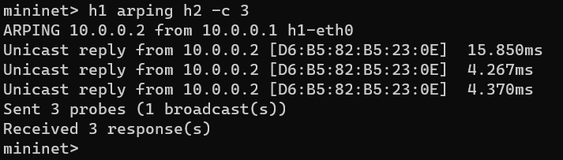
ARP Proxy
Work properly at least in tree (depth=3, fanout=3) topology (40%)
- All hosts are able to arping to each other
Once you activate your application and Mininet, execute arping in Mininet to check ARP functionality
mininet> h1 arping h2
Correct result would look like:

Slide 61
ARP Proxy
Print messages in following events: (10%)
- ARP table miss
- ONOS receives ARP Reply from host
- ARP table hit
You earn credits only if each log pattern is exactly the same as the given one.
We also use log.info() to print messages.

Slide 62
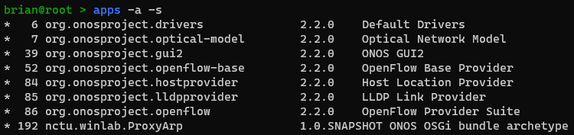
NYCU CS
ARP Proxy
ONOS application activation
‒ You are only allowed to activate your ProxyARP and the following ONOS applications:

Slide 63
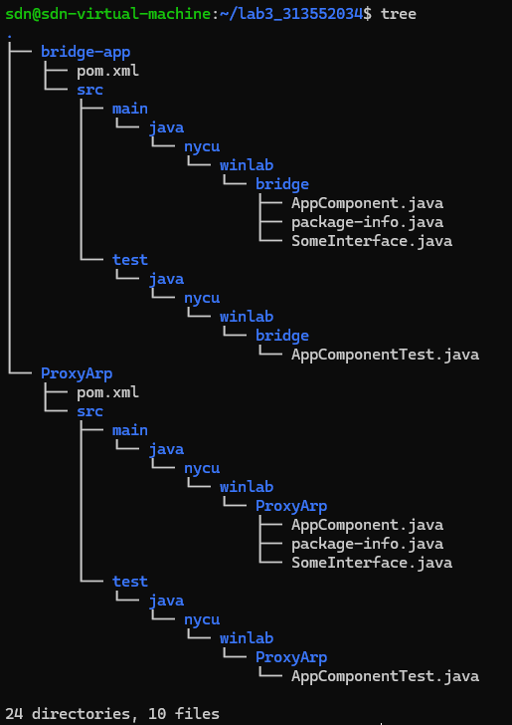
Submission Naming Convention
Move your bridge-app and Proxy ARP into directory lab3_<student ID>
Compress the directory into zip file named as lab3_<student ID>
Wrong file name or format will result in 10 points deduction
20% deduction for late submission in one week
Won’t accept submissions over one week

Slide 64
Lab 3 Demo
TA has opened a demo time-reserved table.
Lab 3 Demo Time-reserved Table
Open Period: 9/26 ~ 10/16 23:59
The demo dates will be in the week after Lab 3 deadline.
Demo questions will show when demo starts.
The demo score will be 40% of total score.
e.g. If your earn 100% credits for submission and 80% credits for demo, then your total score of Lab3 will be 100 x 60% + 80 x 40% = 92.

Slide 65
About help!
For lab problem, ask at e3 forum
Ask at the e3 forum
TAs will help to clarify Lab contents instead of giving answers!
Please describe your questions with sufficient context,
e.g. Environment setup, Input/Output, Screenshots, …
For personal problem mail to sdnta@win.cs.nycu.edu.tw
You have special problem and you can’t meet the deadline
You got weird score with lab
No Fixed TA hours

